Slide 1

Grid Computing
Carlos A. García Márquez
Fernando Ramírez Garibay

Slide 2
Agenda
Introduction
Definition
Grid Architecture
Heterogeneous Computers Internetworking
Characteristics of a Grid
Grid Vs Cluster
Grid Design Considerations
Middleware and Implementations
Grid Computing in the Future

Slide 3
Introducción

Slide 4
Definición
“Grid is used to refer to middleware that is designed to enable the sharing of resources such as files, computers, software, data and sensors on a very large scale […], typically by groups of users in different organizations who are collaborating on the solution of problems requiring large numbers of computers to solve them […] [Grid computing is] supported by heterogeneous computer hardware, operating systems, programming languages and applications.”[1]

Slide 5
Grid Architecture
Application
Application
Collective
Grid Protocol Architecture
Internet Protocol Architecture
Resource
Connectivity
Transport
Internet
Fabric
Link
Layered Grid Architecture and its relationship to the Internet Protocol[2]

Slide 6
Grid Architecture
Application Specific Grid Services e.g. astronomy
Application specific
interfaces
OGSA services: directory, management, security
Standard grid service
Interfaces e.g.
GridService Factory
OGSI services: naming, service data (metadata), service creation and deletion, fault model, service groups
Web Services
Open Grid Services Architecture [1]

Slide 7
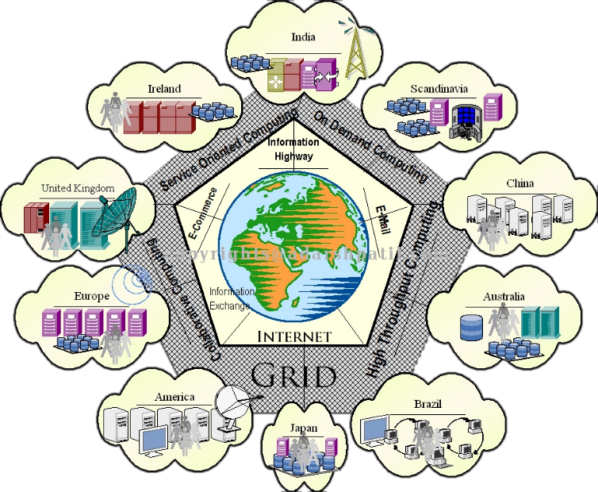
Heterogeneous Computers Internetworking

Slide 8
Characteristics of a Grid

Slide 9
Grid vs Cluster
Grid
Cluster
More heterogeneous
More loosely coupled
Low speed network (Comparatively)
Across administrative domains
Geographically distributed (often)
More likely to change size
Granularity: Largely coarse
More specifically defined hardware
More tightly coupled
High speed network
Local area network
Found in a defined physical location (often)
Less likely to change
Granularity: Fine-coarse

Slide 10
Grid Design Considerations
“The disappearing machine”: Assume that any node will go on vacation… Indefinitely.
Security: Assume that you’ll be sharing your data with everyone.
Heterogeneity: Consider that you might be working with ARM microprocessors as well as with Pentium II’s.
Idle time: Know that you’ll be the last priority on any machine.
Granularity: Then, assign large, secured tasks that you’ll be ready to reassign at any time. Make it resilient.

Slide 11
Middleware and Implementations
Grid Computing Available.
Globus Toolkit
Ngrid
BOINC
Oracle Grid Infraestructure
Some projects that are using grid computing:
European Grid Infrastructure - 2001
Butterfly Grid (Multiplayer Games Platform - IBM) - 2002

Slide 12
Grid Computing in the Future
Evolution from grid computing to cloud computing
They are not the same.
The buzz around cloud computing is eating grid computing away.
Whatever we call it:
It can be combined with ubiquitous computing.

Slide 13
Bibliography
[1] “Archive material for Edition 4 Distributed Systems: Concepts and Design”, George Colorious, Jean Dollimore, Tim Kindberg and Gordon Blair. Ed. Addison-Wesley, 2012.
[2] “The Anatomy of the Grid”, Ian Foster, Carl Kesselman and Steven Tuecke. Mathematics and Computer Science Division, Argonne National Laboratory, Argone, IL; Department of Computer Science, The University of Chicago, Chicago, IL; Information Science Institute, The University of Southern California, Marina del Rey, CA.
[3] “Distributed Systems: Concepts and Design”, George Colorious, Jean Dollimore, Tim Kindberg and Gordon Blair. Ed. Addison-Wesley, 2012.
[4] “Cluster, Grid and Cloud Computing: A Detailed Comparison”, Naidila Sadashiv Dept and S. M. Kumar. IEEE 2011.
[5] http://toolkit.globus.org/toolkit/
[6] http://ngrid.sourceforge.net/
[7] http://boinc.berkeley.edu/

